Slide 1
WordCount using Spark in Java
Step-by-Step
BigDataMiningLab.

Slide 2
Import Spark Libraries into Project

Slide 3
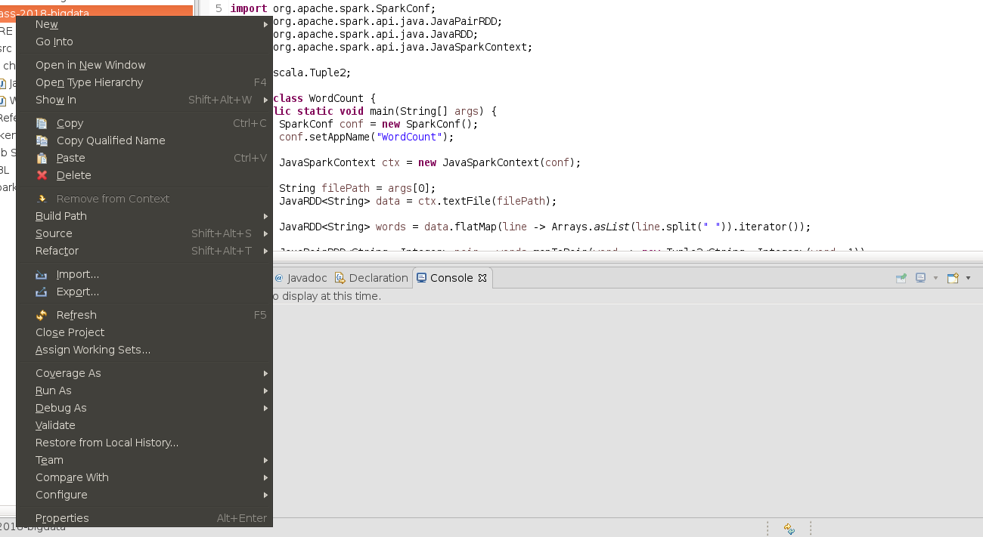
Import Spark Libraries
Click

Slide 4
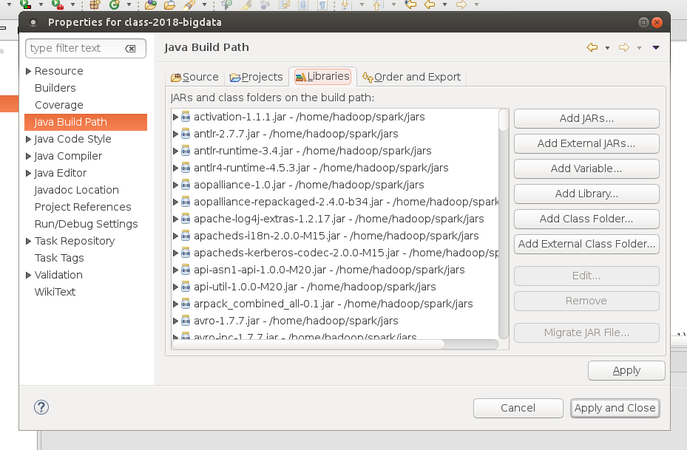
2
1
3

Slide 5
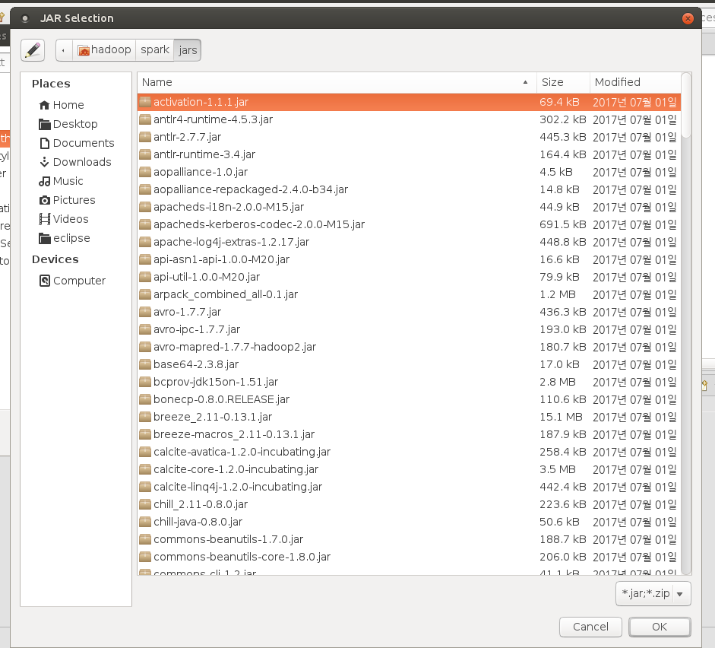
$SPARK_HOME/jars
EX) ~/spark/jars/
Select all file and click “OK”

Slide 6
Apply and close

Slide 7
Export “jar”

Slide 8
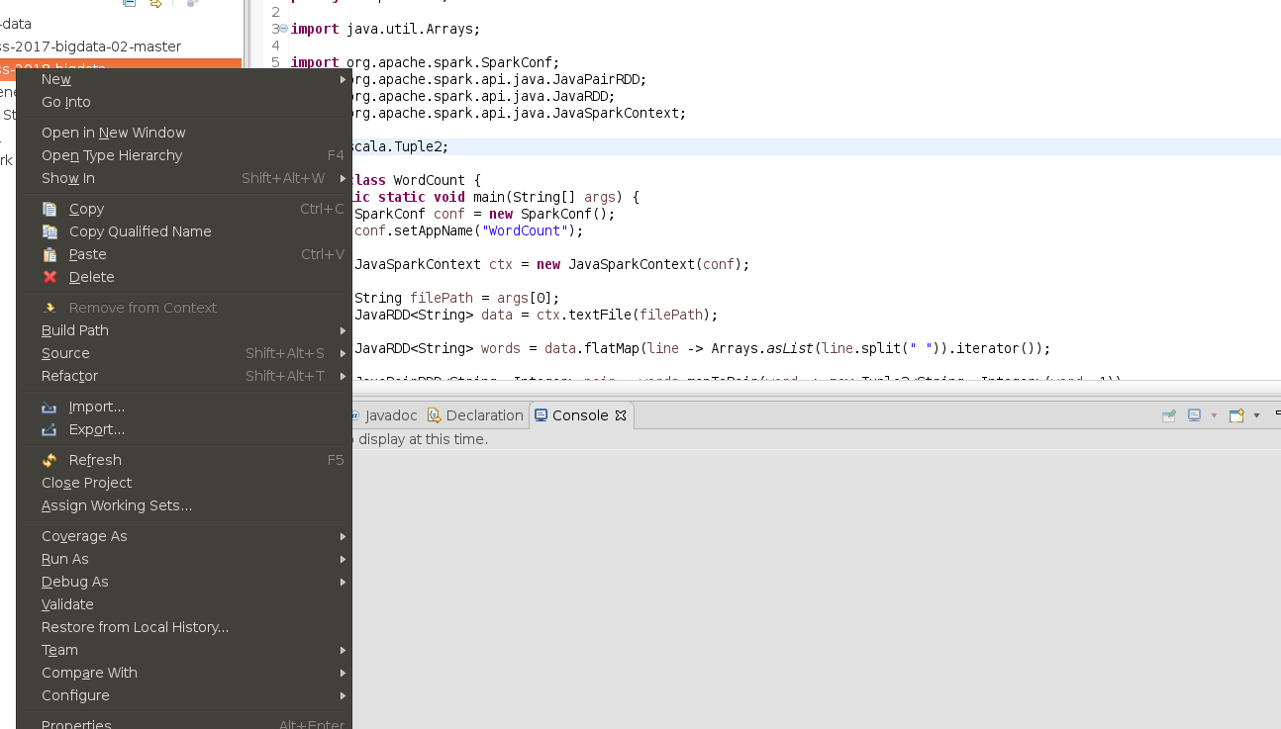
Click

Slide 9
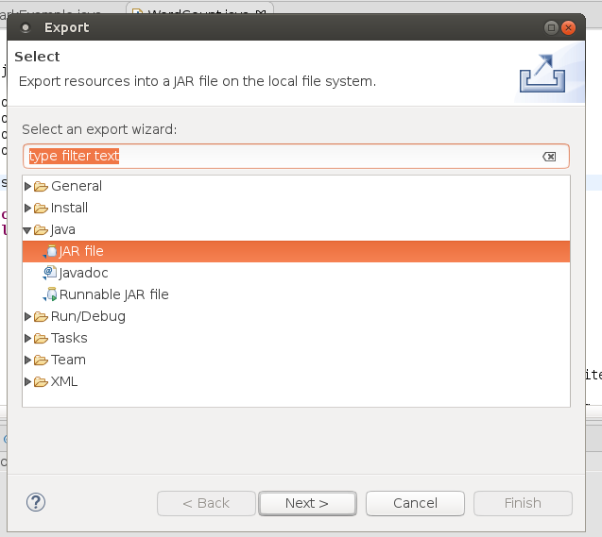
1
2

Slide 10
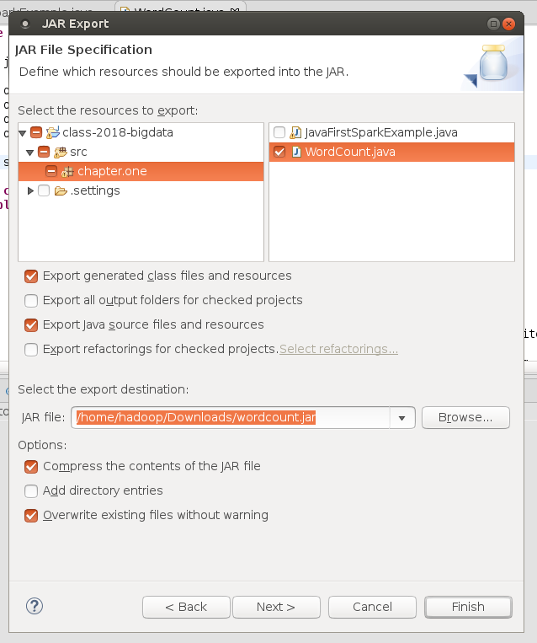
1
2
3

Slide 11
Run WordCount

Slide 12
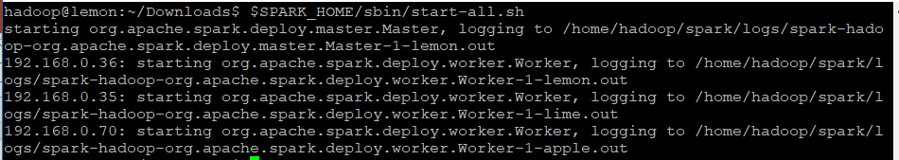
$SPARK_HOME/sbin/start-all.sh

Slide 13
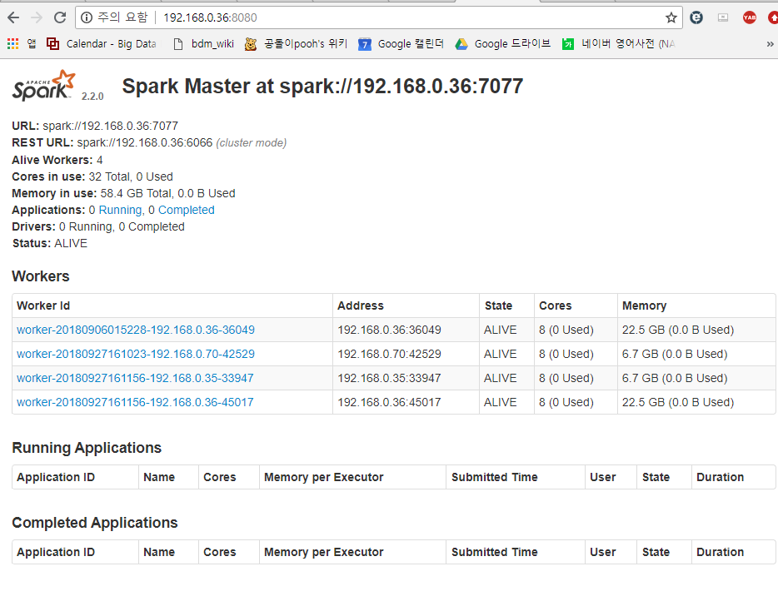
Spark UI
localhost:7077
Check where is spark running

Slide 14
Package name
For default package, it should be empty.
Ex) chapter.one.WordCount -> WordCount
Class name
$SPARK_HOME/bin/spark-submit --class chapter.one.WordCount –master spark://localhost:7077 wordcount.jar $SPARK_HOME/README.md
File path

Slide 15
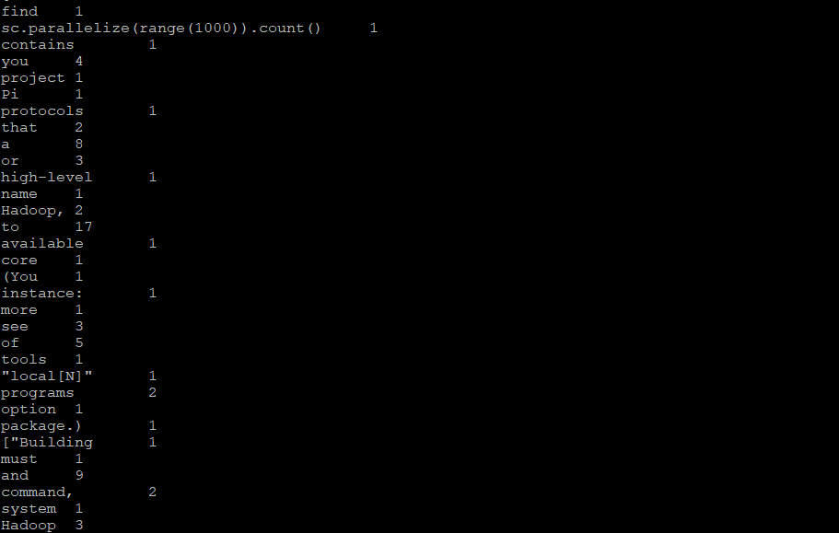
Result

Slide 16
If you have any question, please feel free to email TA (woongheelee@hanyang.ac.kr).
Make an appointment and visit the lab.

